Slide 1
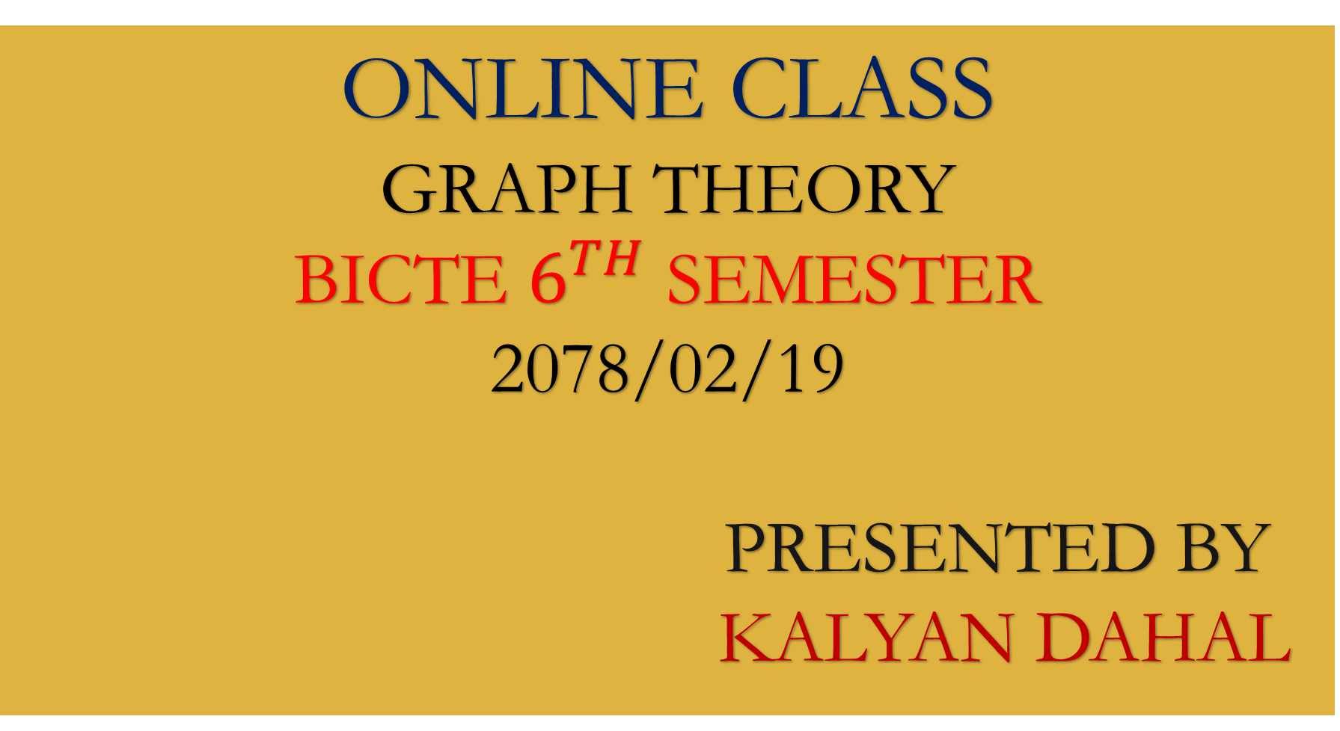
ONLINE CLASS
GRAPH THEORY
BICTE $6^{TH}$ SEMESTER
2078/02/19
PRESENTED BY KALYAN DAHAL

Slide 2
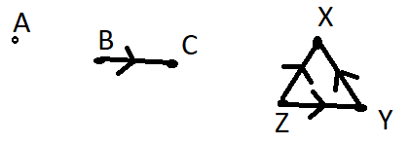




Tournaments
Tournament:
A tournament is a directed loop free digraph T = (V, A) such that u, v $∈$ V and u $≠$ v, implies either (u, v) $∈$ A or (v, u) $∈$ A but not both.
The tournament is defined as a digraph which has no directed loops and any two different vertices are linked by an arc.
$$T_{1}$$
$$T_{3}$$
$$T_{2}$$

Slide 3
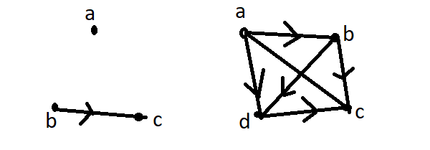



Continued…..
The digraphs given below is not tournament.
Since, a, b $∈$ V and a $≠$ b, but neither (a, b) $∉$ A($T_{1}$) nor (b, a) $∉$ A($T_{1}$) and similarly, a, c $∈$ V and a $≠$ c but, (a, c) $∉$ A($T_{2}$) and (c, a) $∉$ A($T_{2}$)
$$T_{1}$$
$$T_{2}$$

Slide 4

Round-robin tournaments
Round-robin tournament:
The round-robin tournament is a specific type of digraph which is commonly used as a tie-sheet for sport competition.
Note:
If we provided directions to the arcs of a complete digraph, it gives us a tournament.
A single tournament is represented by two vertices as given below.

Slide 5
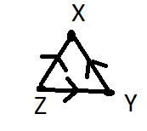
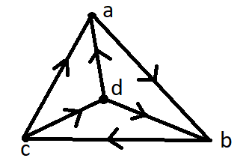
Continued……
3. There are two tournament in the digraph with three vertices.
4. A digraph having four vertices represents the four tournaments.

Slide 6
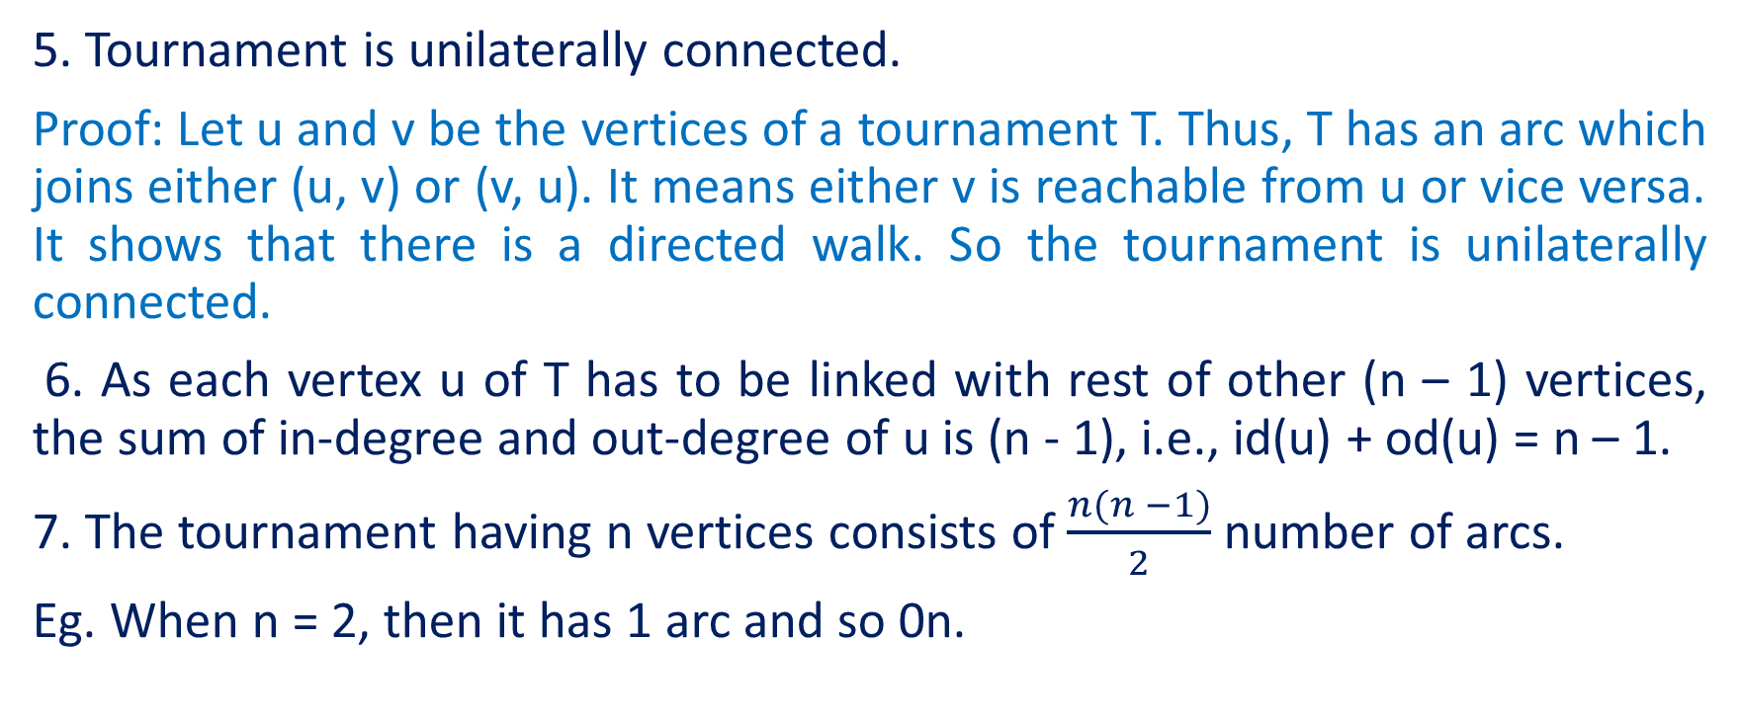
Continued…..
5. Tournament is unilaterally connected.
Proof: Let u and v be the vertices of a tournament T. Thus, T has an arc which joins either (u, v) or (v, u). It means either v is reachable from u or vice versa. It shows that there is a directed walk. So the tournament is unilaterally connected.
6. As each vertex u of T has to be linked with rest of other (n – 1) vertices, the sum of in-degree and out-degree of u is (n - 1), i.e., id(u) + od(u) = n – 1.
7. The tournament having n vertices consists of $\frac{n(n −1)}{2}$ number of arcs.
Eg. When n = 2, then it has 1 arc and so 0n.

Slide 7
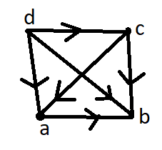
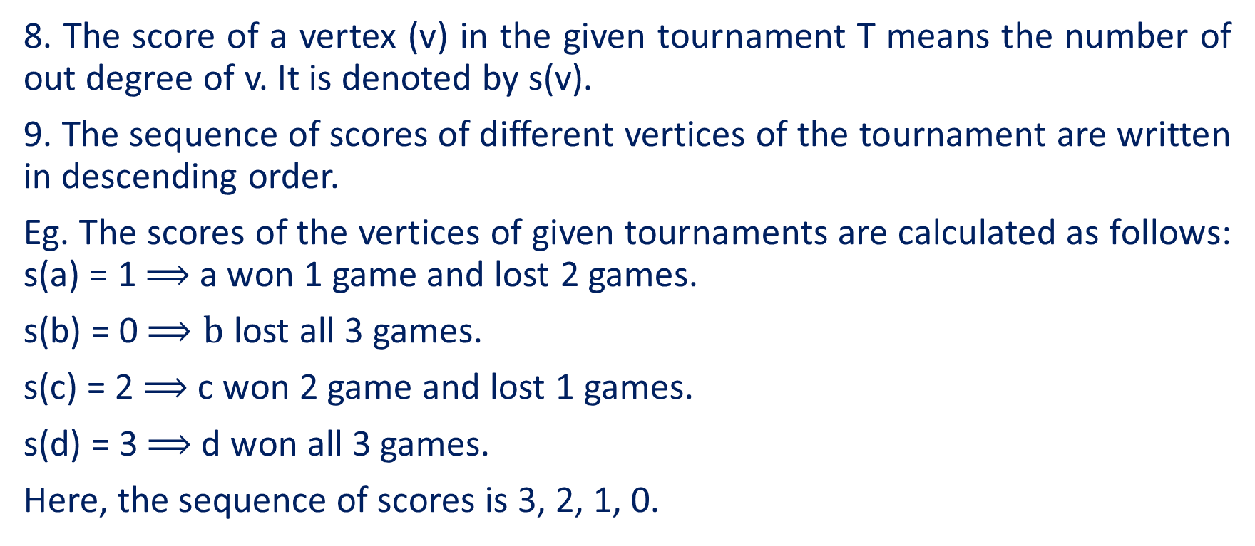
Continued…..
8. The score of a vertex (v) in the given tournament T means the number of out degree of v. It is denoted by s(v).
9. The sequence of scores of different vertices of the tournament are written in descending order.
Eg. The scores of the vertices of given tournaments are calculated as follows: s(a) = 1 $⟹$a won 1 game and lost 2 games.
s(b) = 0 $⟹b$ lost all 3 games.
s(c) = 2 $⟹$c won 2 game and lost 1 games.
s(d) = 3 $⟹$d won all 3 games.
Here, the sequence of scores is 3, 2, 1, 0.

Slide 8
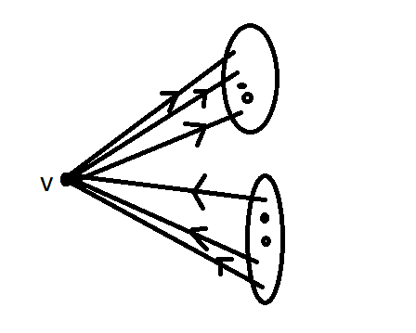

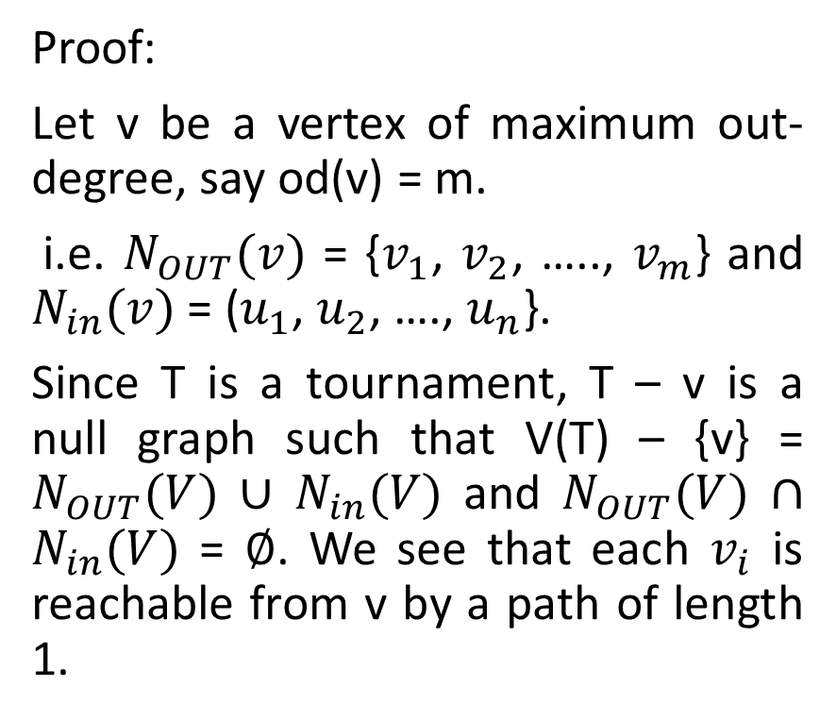







Every tournament T contains a vertex from which every other vertex is reachable by a path of length at mist 2.
Proof:
Let v be a vertex of maximum out-degree, say od(v) = m.
i.e. $N_{OUT}(v)$ = {$v_{1}$, $v_{2}$, ….., $v_{m}$} and $N_{in}(v)$ = ($u_{1}$, $u_{2}$, …., $u_{n}$}.
Since T is a tournament, T – v is a null graph such that V(T) – {v} = $N_{OUT}(V)$ $∪$ $N_{in}(V)$ and $N_{OUT}(V)$ $∩$ $N_{in}(V)$ = $∅$. We see that each $v_{i}$ is reachable from v by a path of length 1.
$$v_{1}$$
$$v_{2}$$
$$N_{OUT}(v)$$
$$v_{m}$$
$$u_{n}$$
$$N_{IN}(v)$$
$$u_{2}$$
$$u_{1}$$

Slide 9
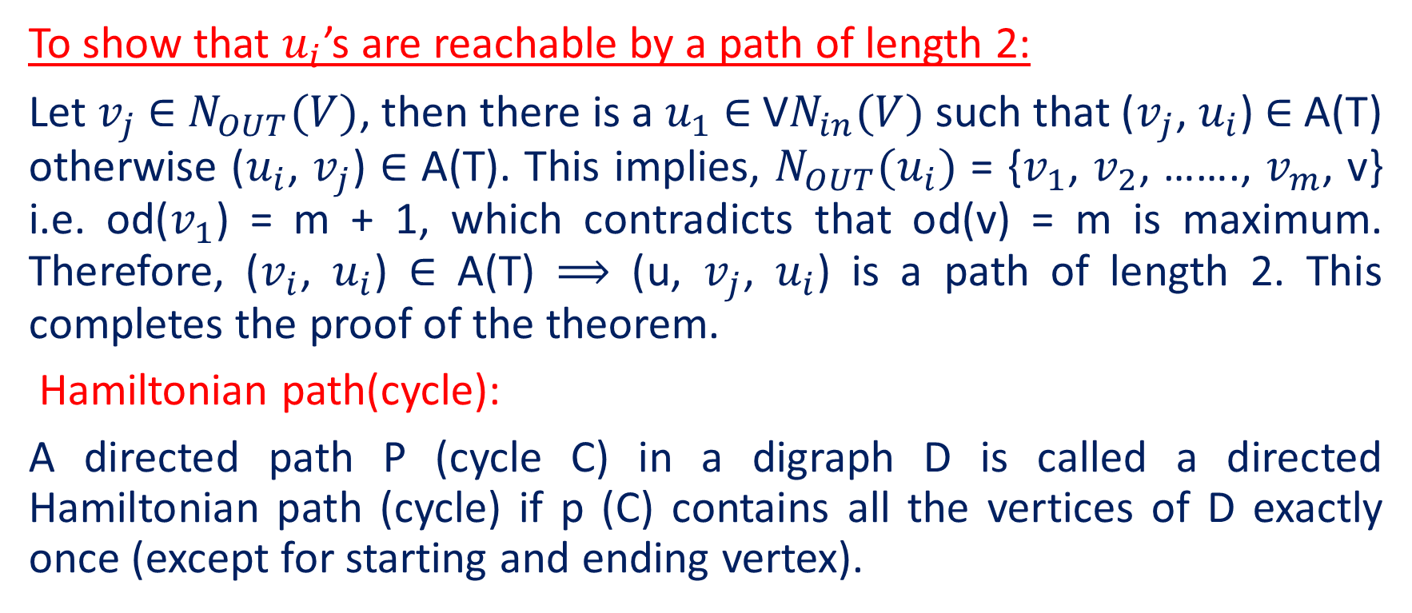
Continued…..
To show that $u_{i}$’s are reachable by a path of length 2:
Let $v_{j}$ $∈$ $N_{OUT}(V)$, then there is a $u_{1}$ $∈$ V$N_{in}(V)$ such that ($v_{j}$, $u_{i}$) $∈$ A(T) otherwise ($u_{i}$, $v_{j}$) $∈$ A(T). This implies, $N_{OUT}(u_{i})$ = {$v_{1}$, $v_{2}$, ……., $v_{m}$, v} i.e. od($v_{1}$) = m + 1, which contradicts that od(v) = m is maximum. Therefore, ($v_{i}$, $u_{i}$) $∈$ A(T) $⟹$ (u, $v_{j}$, $u_{i}$) is a path of length 2. This completes the proof of the theorem.
Hamiltonian path(cycle):
A directed path P (cycle C) in a digraph D is called a directed Hamiltonian path (cycle) if p (C) contains all the vertices of D exactly once (except for starting and ending vertex).

Slide 10
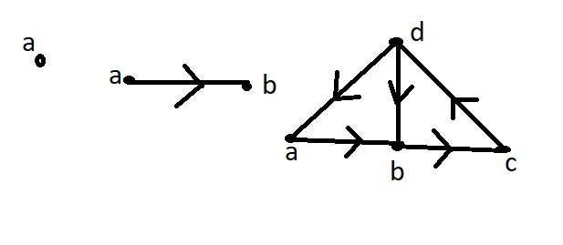

Continued…..
Here, the path $P_{1}$ =a, $P_{2}$ = {a, b} and $P_{3}$ ={a, b, c, d} are Hamiltonian path and C = {a, b, c, d, a} is a Hamiltonian cycle.
Hamiltonian digraph: A digraph D is said to be Hamiltonian digraph if contains a Hamiltonian cycle.
The digraph having a directed Hamiltonian cycle is called Hamiltonian.

Slide 11
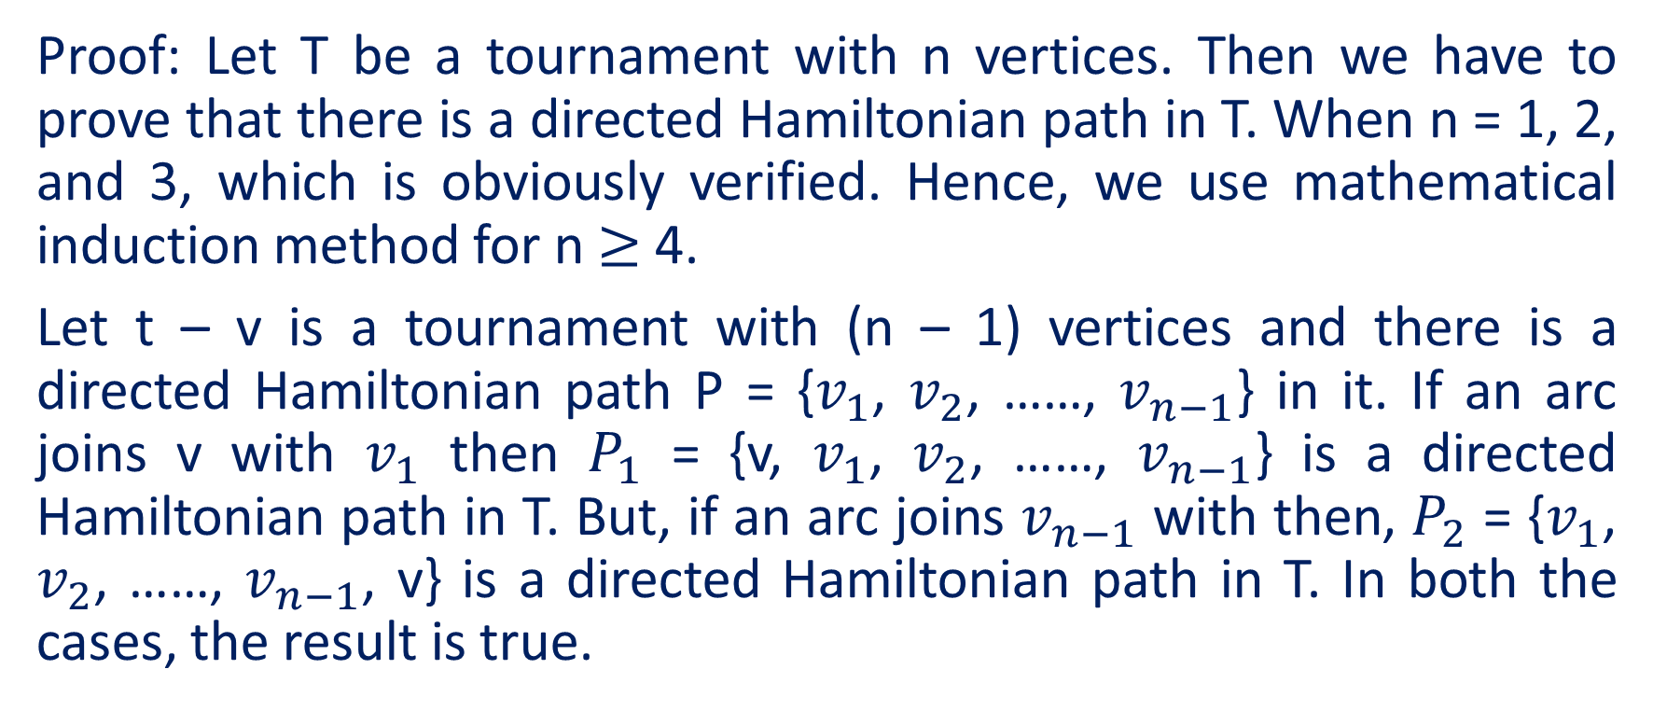
Every tournament T has a directed Hamiltonian path.
Proof: Let T be a tournament with n vertices. Then we have to prove that there is a directed Hamiltonian path in T. When n = 1, 2, and 3, which is obviously verified. Hence, we use mathematical induction method for n $≥$ 4.
Let t – v is a tournament with (n – 1) vertices and there is a directed Hamiltonian path P = {$v_{1}$, $v_{2}$, ……, $v_{n−1}$} in it. If an arc joins v with $v_{1}$ then $P_{1}$ = {v, $v_{1}$, $v_{2}$, ……, $v_{n−1}$} is a directed Hamiltonian path in T. But, if an arc joins $v_{n−1}$ with then, $P_{2}$ = {$v_{1}$, $v_{2}$, ……, $v_{n−1}$, v} is a directed Hamiltonian path in T. In both the cases, the result is true.

Slide 12
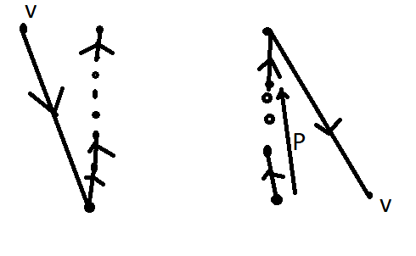

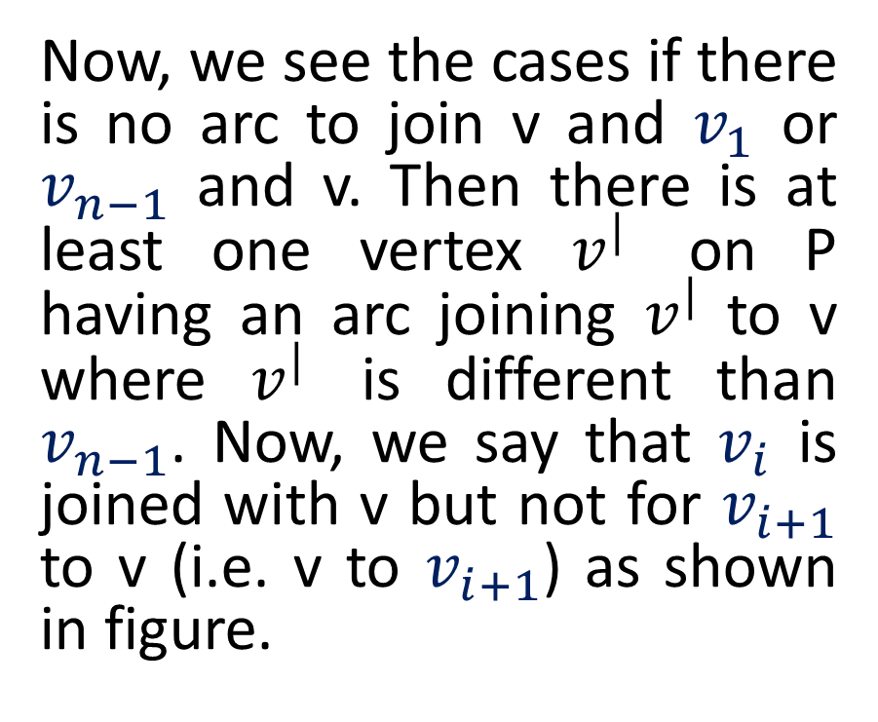





Continued….
Now, we see the cases if there is no arc to join v and $v_{1}$ or $v_{n−1}$ and v. Then there is at least one vertex $v^{|}$ on P having an arc joining $v^{|}$ to v where $v^{|}$ is different than $v_{n−1}$. Now, we say that $v_{i}$ is joined with v but not for $v_{i+1}$ to v (i.e. v to $v_{i+1}$) as shown in figure.
$$v_{n−1}$$
$$v_{n−1}$$
$$v_{2}$$
$$v_{2}$$
$$v_{1}$$
$$v_{1}$$

Slide 13
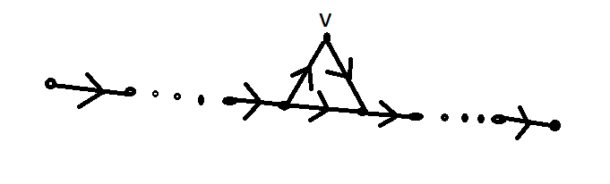






Continued…..
In this way, the path $P_{3}$ = {$v_{1}$, $v_{2}$, ……, $v_{i}$, v, $v_{i+1}$, ……, $v_{n−1}$} provides a directed Hamiltonian path in the digraph D. hence, it completes the proof of the theorem.
$$v_{1}$$
$$v_{2}$$
$$v_{i}$$
$$v_{i+1}$$
$$v_{n−1}$$

Slide 14
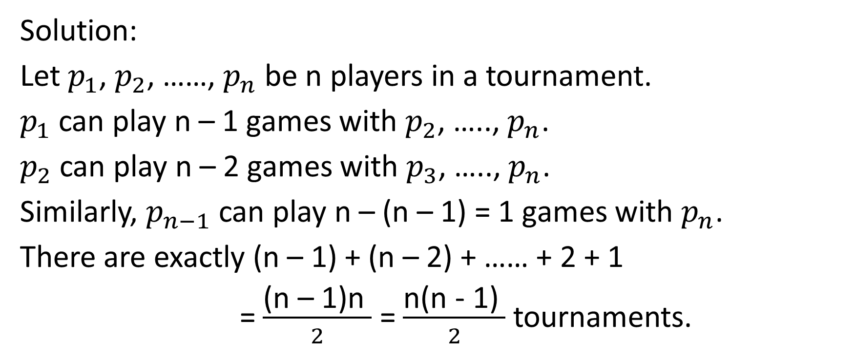
How many different tournaments are there with n players?
Solution:
Let $p_{1}$, $p_{2}$, ……, $p_{n}$ be n players in a tournament.
$p_{1}$ can play n – 1 games with $p_{2}$, ….., $p_{n}$.
$p_{2}$ can play n – 2 games with $p_{3}$, ….., $p_{n}$.
Similarly, $p_{n−1}$ can play n – (n – 1) = 1 games with $p_{n}$.
There are exactly (n – 1) + (n – 2) + …… + 2 + 1
= $\frac{\text{(}\text{n}\text{ – 1)}\text{n} }{2}$ = $\frac{\text{n}\text{(}\text{n}\text{ − 1)} }{2}$ tournaments.

Slide 15
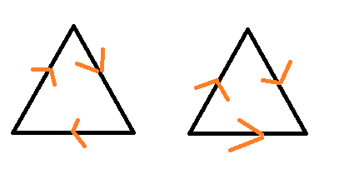
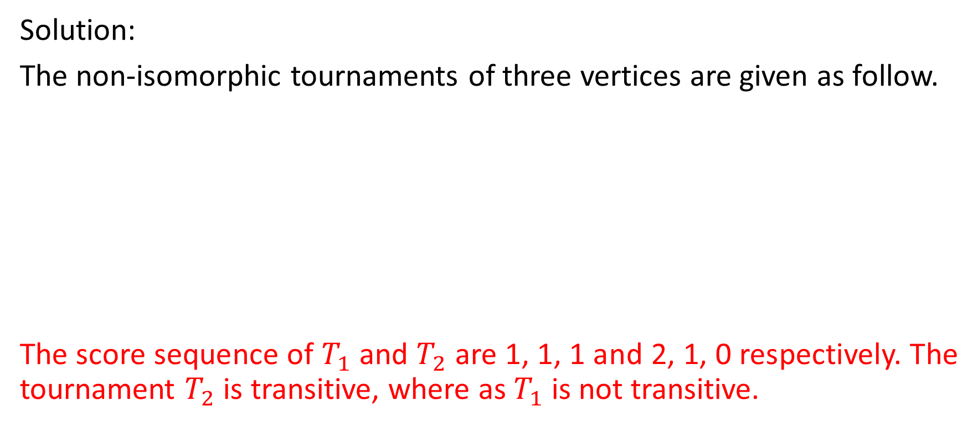
Draw all non-isomorphic tournaments with three vertices and give the sequences of each. Which of these are transitive?
Solution:
The non-isomorphic tournaments of three vertices are given as follow.
The score sequence of $T_{1}$ and $T_{2}$ are 1, 1, 1 and 2, 1, 0 respectively. The tournament $T_{2}$ is transitive, where as $T_{1}$ is not transitive.

Slide 16
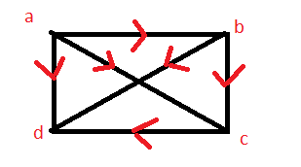
If five team play in around-robin tournament. Show that it is possible for all five teams to tie for first time.
Solution:
In a round-robin tournament of five players each player has to play four games. There is a possibility that each player can win two games and losses two games. In this way, there is a possibility of a tie in the first time.
Find the score sequences of the vertices of the tournament.
Solution: s(a) = 3 , s(b) = 1 , s(c) = 1,
S(d) =1. the score sequences is 3, 2, 1, o.

Slide 17


